Slide 1

Just Breathe: A Breathing Control App to Manage Well-Being
Authors:
Francesco Bruno
Gaetano Sferrazza
Lorenzo Tonelli
Nicolò Picchi

Slide 2

OUTLINE
INTRODUCTION
JUST BREATHE – GUI DESCRIPTION
ARCHITECTURE
BREATHING SIGNAL SCORE
EXPERIMENTAL RESULTS
CONCLUSION
VIDEO DEMONSTRATION

Slide 3

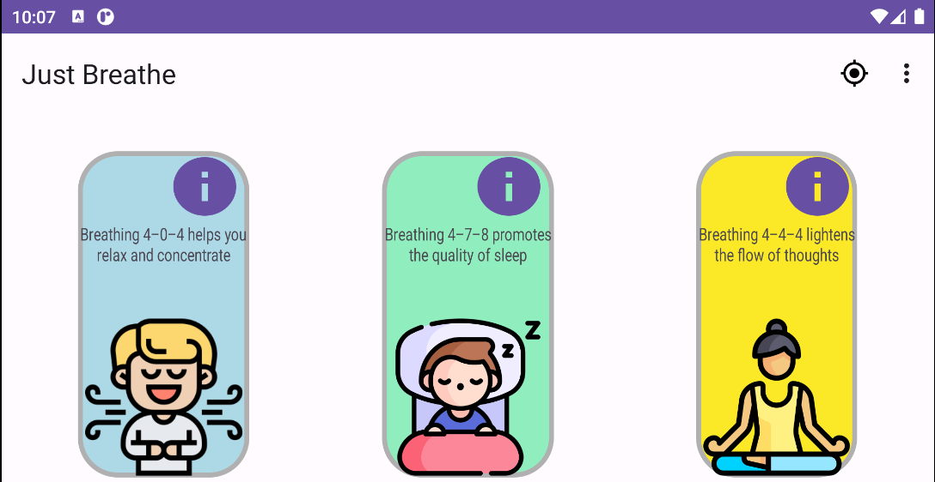
INTRODUCTION
Breathing is an automatic function of the body that is controlled by the respiratory centre of the brain
Breathing control is a fundamental operation to manage emotions or states of confusion.
Just Breathe is an intuitive application to follow a breathing pattern
Just Breathe Objective: help a user to improve its breathing control

Slide 4

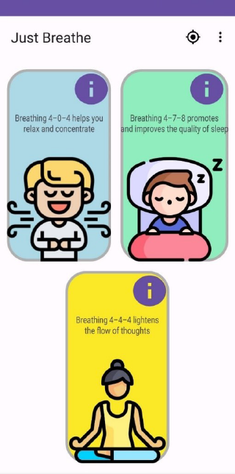
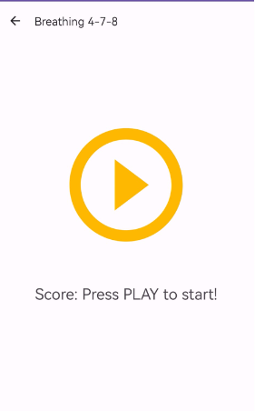
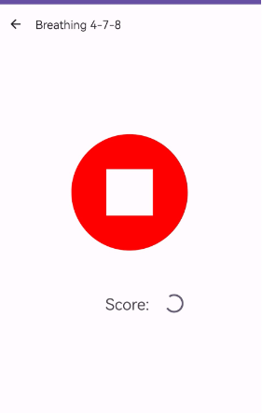
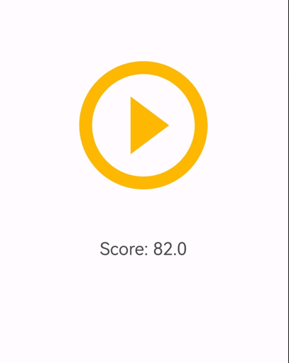
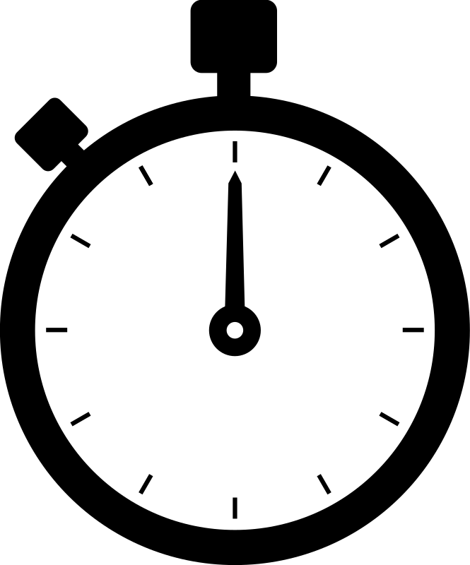
JUST BREATHE – GUI DESCRIPTION
We recommend Calibration
Click con info button to have more info about that pattern
Chose one of three pattern by clicking on one picture
We suggest to use a watch to take the time of breathing.

Slide 5
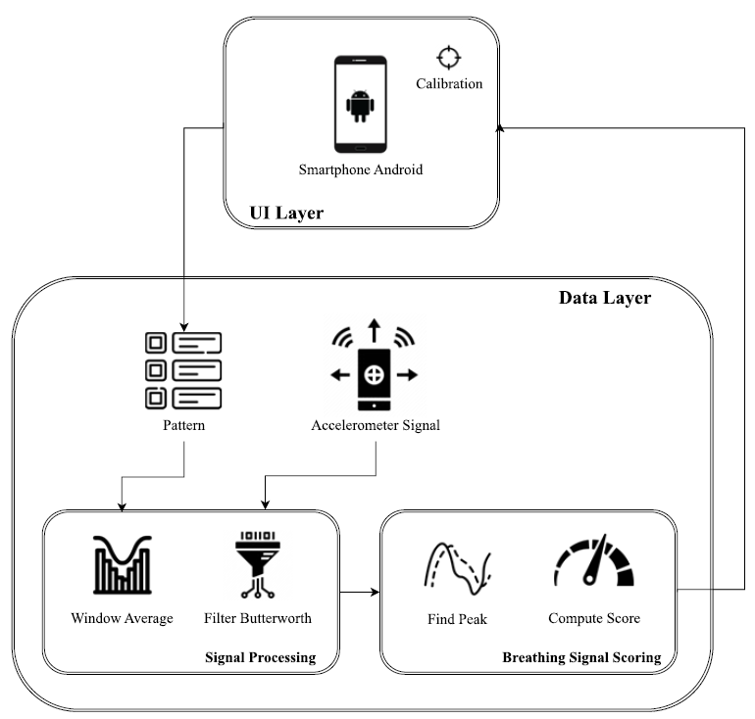


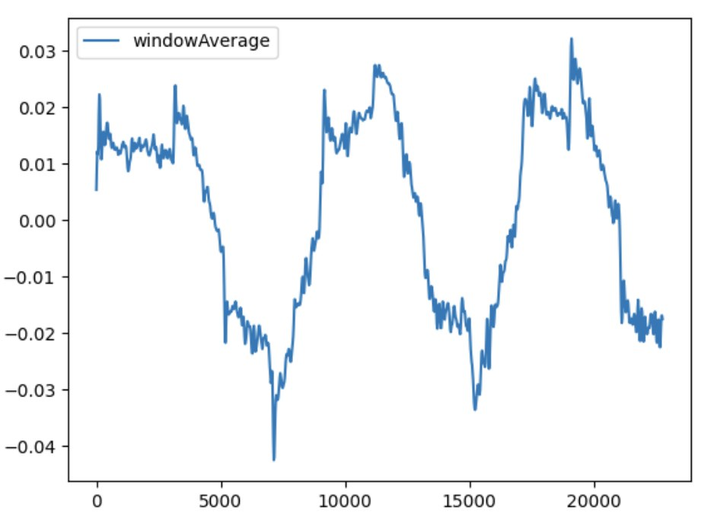
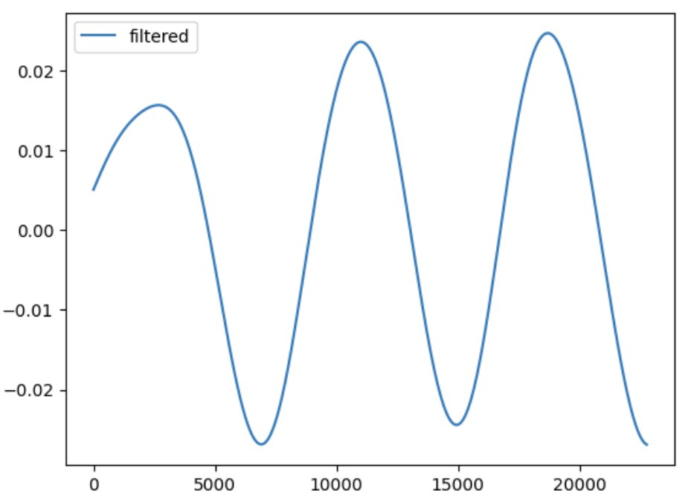
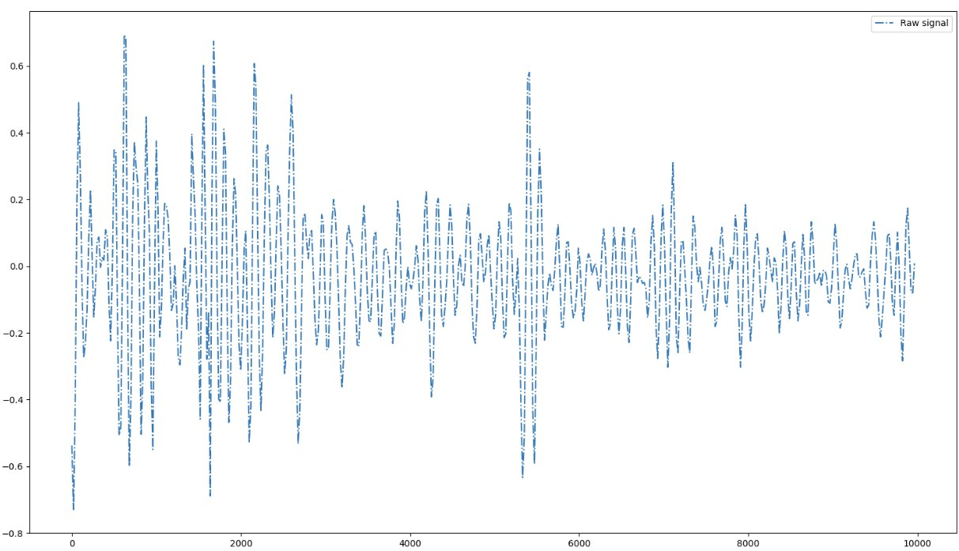




ARCHITECTURE
PATTERN 4-0-4
Recommended calibration
Pattern choice by graphical interface
Accelerometer signals processing:
1. Calculation of the window average
2. Signal filtering through the Butterworth filter
Computation of the respiratory signal score in according to the pattern
Finding of peak function
Application of the formula for scorin
Return of the score to the GUI
Notes:
The first action that the user should always do is the calibration. Calibration is the process that removes the contribution of the weight force from the subsequent measurements. Although the signal recorded by the accelerometer already excludes the weight force, if we place the phone on a flat surface, the value will not be precisely 0 due to the error on the measurement. By pressing the calibration button on the GUI, the mean of the weight force along the z-axis of 100 samples is calculated, and the result subtracted from subsequent measurements.
In the second phase the user chooses a breathing pattern among the three possible, through the GUI.
In the third step, the data are collected by the accelerometer and the restult signal is processed in two ways:
First, a window average is applied to the raw accelerometer data to smooth-out short-term fluctuations and highlight longer-term trends or cycles. After several attempts, a time window of 125 samples was chosen. The result is as shown in the figure. In this case we have a breathing session by choosing the 4-0-4 pattern. On the left we can see the raw data recorded by the accelerometer. On the x-axis we have the time in milliseconds and on the y-axis we have the acceleration expressed in meter over seconds squared.
Later, the signal obtained was filtered by means of a Butterworth filter in low-pass mode with a cut-off frequency of 0.25Hz. This frequency was chosen because the frequency of human breathing is around 0.2Hz, 0.4Hz. After passing through the filter, the signal shows this trend.
At this point, in order to provide a score to the breathing session, as my colleague Lorenzo will explain better in the next slides, the maximum and minimum local peaks were found and according to the type of pattern chosen in the previous phase, the score was calculated.
Finally, the latter is returned to the GUI where the user can read it.

Slide 6
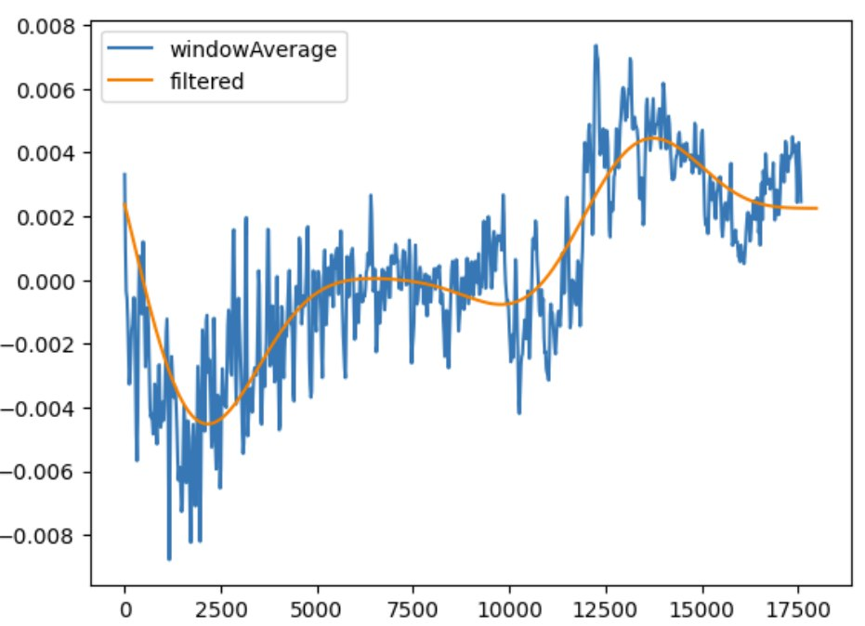
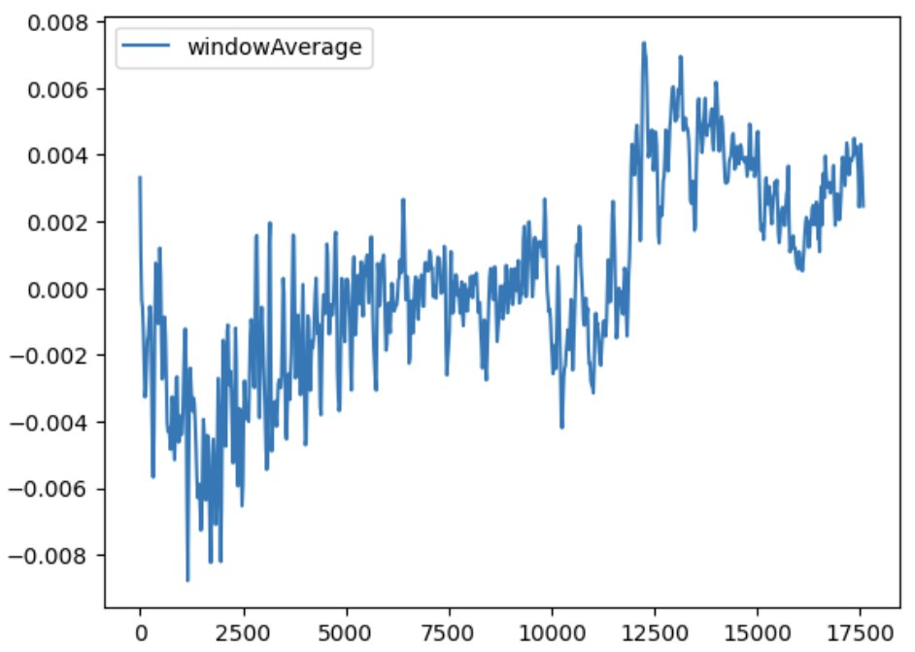
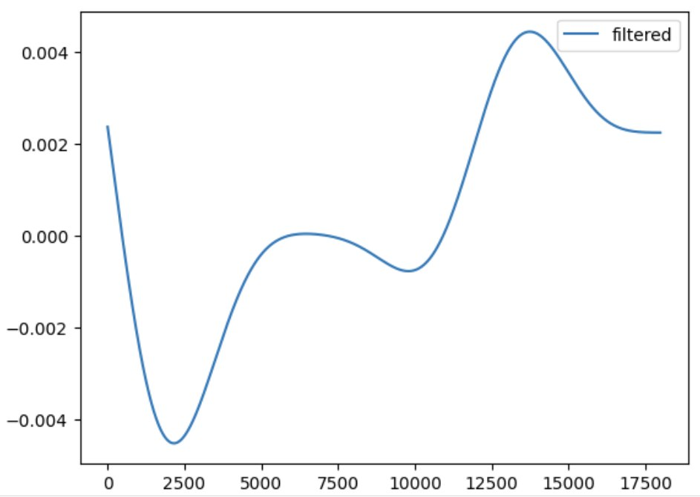
PATTERN 4-7-8
Notes:
In the following slides, I will show an example of a breathing session with the 4-7-8 pattern, in which there is also a hold interval of 7 seconds. This parameter will also be important in measuring the score.
Here we can see the signal after passing from the average window and here after being filtered.
We can clearly distinguish the inhalation phase, the holding phase and finally the exhalation phase.

Slide 7
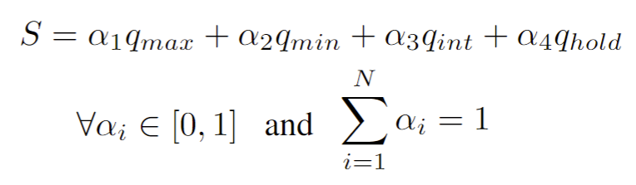
BREATHING SIGNAL SCORE – DESCRIPTION
To measure the goodness of a user's breathing, a heuristic algorithm has been developed, breathingScore().
It takes as input the processed breath signal and the pattern to follow.
Returns a value between 0 and 1 which will be multiplied by 100 before showing it on the smartphone screen.
𝑞𝑚𝑎𝑥: is the index that measures how close the local maximum peaks are to their average
𝑞𝑚𝑖𝑛: is the index that measures how close the local minimum peaks are to their average
𝑞𝑖𝑛𝑡: is the index that measures how much the period of inhalation and exhalation corresponds
𝑞ℎ𝑜𝑙𝑑: is the index that measures the general goodness of the apnea periods of the entire session
Notes:
To measure the goodness of a user's breathing, a heuristic algorithm has been developed, breathingScore().
It takes as input the processed breath signal and the pattern that the user tries to follow, the pattern has been observed are 404, 478 and 444.
Returns a value between 0 and 1 which will be multiplied by 100 before showing it on the smartphone screen.
The score is obtained through the combination of 4 indices: qmax, qmin, qint, qhold while alpha1, alpha2, alpha3 and alpha4 are the weights used to give a different importance to the indices.
The weights and indices have a value that belongs between 0 and 1 in addition the sum of weights must be equal to 1.
𝑞𝑚𝑎𝑥: is the index that measures how close the local maximum peaks are to their average
𝑞𝑚𝑖𝑛: is the index that measures how close the local minimum peaks are to their average
𝑞𝑖𝑛𝑡: is the index that measures how much the period of inhalation and exhalation corresponds
𝑞ℎ𝑜𝑙𝑑: is the index that measures the general goodness of the apnea periods of the entire session
For the breathing pattern 404, in which the apnea phase is not present, the Score function (1) does not have the component 𝛼4 𝑞ℎ𝑜𝑙𝑑 .

Slide 8
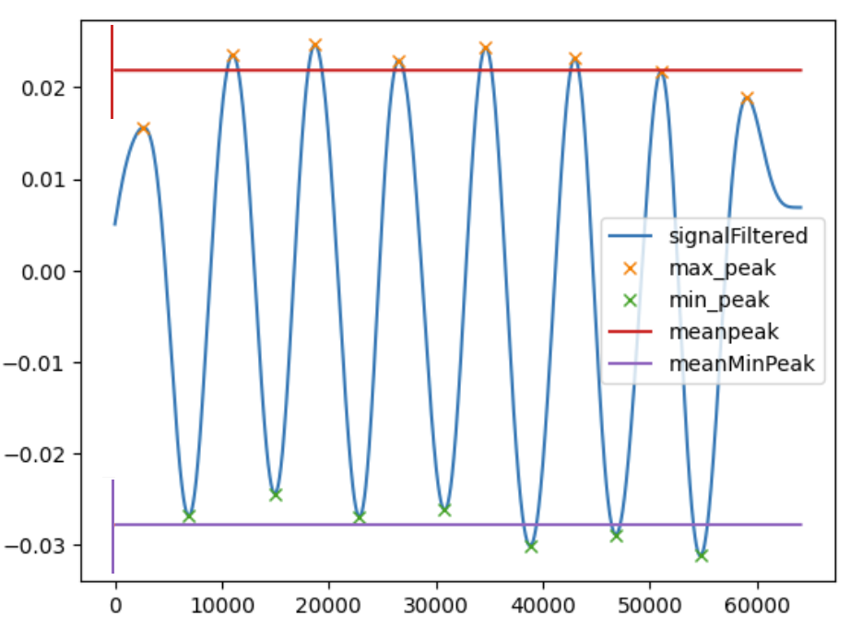
BREATHING SIGNAL SCORE – EXAMPLE
An example of breathingScore() that takes as input the signal in the figure with following parameters:
peak_max_tollerance = 0.005 m/s^2
peak_min_tollerance = 0.005 m/s^2
breath_period_tollerance = 500ms
𝛼1= 𝛼2= 0.25, 𝛼3 = 0.50
Computing:
q_min = 8/8 = 1
q_max = 7/8 = 0.875
q_int = 15/15 = 1
S = 0.25 q_min + 0.25 q_max + 0.50 q_int = 0.954 -> 95.4
Notes:
Let's see an example of BrathingScore() which takes as input the signal in the figure with the following parameters.
peak_max_tolerance = 0.005 meters per second squared, peak_min_tolerance = 0.005 breath_period_tolerance = 500ms 𝛼1= 𝛼2= 0.25, 𝛼3 = 0.50
The figure shows the minimum and maximum peaks and their average value. These vertical segments indicate the tolerance of the peaks.
This is a breathing signal obtained by trying to get the maximum score. During the session, the user looked at a watch to synchronize the breathing rate as best as possible.
By eye we can evaluate the ratio of the indices of q_min and q_max. Just a high peak isn't close enough to the mean. All periods/intervals of inspiration and expiration have a duration between 3500ms and 4500ms.So the resulting score is 0.954.

Slide 9
EXPERIMENT RESULTS – CHOICE OF HYPERPARAMETERS
Peak Tolerance | Breath Period Tolerance | $$α_{1}= α_{2}$$ | $$α_{3}$$
0.15 | 1000 | 0.3 | 0.4
0.005 | 500 | 0.25 | 0.5
Useful Considerations:
Each user reported difficulties in respecting the chosen breathing pattern for over 40 seconds.
Each user has a different abdominal extensibility and sensitivity
Two users stated that keeping the breathing rhythm accurate to the ideal one was difficult.

Slide 10
EXPERIMENT RESULTS – TEST-SET
The test-set created to conduct the experiments was defined as follows:
Breathing Pattern: 4-0-4 for all registration sessions
Environment Set: User lying on bed with smartphone resting on abdomen
Breathing Session Duration: At least 45s
Session Type: 50% Correct - 50% Incorrect (compared to the chosen pattern)
Beta-Version of the JustBreathe App to sperimentation
60 breathing sessions were collected on a sample of 4 male persons, same build and breathing capacity who installed the JustBreathe app on their Android Smartphone

Slide 11
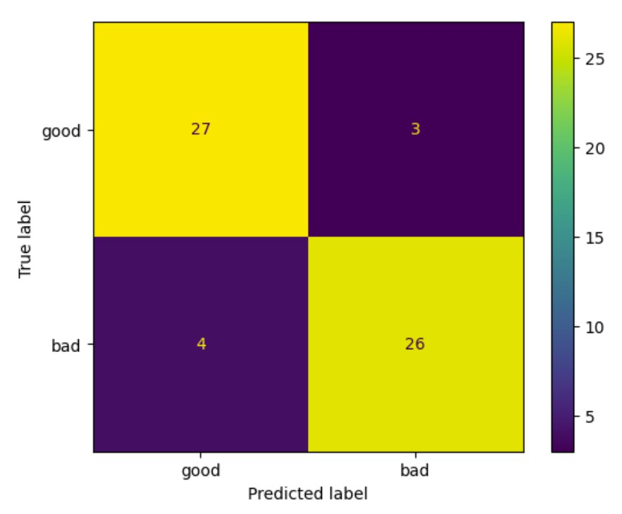
EXPERIMENT RESULTS – MEASUREMENT OF SCORE RELIABILITY
Sessions Labels:
“Good”: When the user breathed in the manner closest to the chosen breathing pattern
“Bad”: When the user did not breathe in the manner close to the chosen breathing pattern
 | Precision | Recall | F1-Score | Support
“Good” | 0.90 | 0.87 | 0.88 | 30
“Bad” | 0.87 | 0.90 | 0.89 | 30
Accuracy |  |  | 0.88 | 60
Table: Metrics Results

Slide 12
CONCLUSION
Advantages:
Original and innovative solution in the mobile app industry dedicated to supporting user breathing
Reduced complexity due to the fact that no AI technique is required
Easy to use and based on an unobtrusive approach for the monitoring phase
Limitations:
JustBreathe App is not yet ready for large-scale use
Choice of Hyperparameters based on a too small sample of users
Physiological characteristics of the users
Noise in the raw signal obtained from the accelerometer

Slide 13

VIDEO DEMONSTRATION

Slide 14


THANKS FOR YOUR ATTENTION!
THANKS
FOR YOUR ATTENTION

Slide 15
REFERENCES
[1]. Francesco Bruno; Gaetano Sferrazza; Lorenzo Tonelli; Nicolò Picchi,
Manage Well-Being Through a Breathing Control App https://github.com/francescoB1997/Just_Breathe

